Slide 1

StackStorm Commands for Actions
(st2 CLI Commands for Action )
NarendraP
StackStorm: Event-Driven Automation Tool for DevOps and Infrastructure

Slide 2
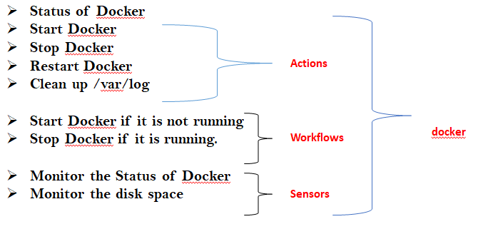
Simple StackStorm Commands for Actions
What is an Action ?
Action: It a command or a script and we can automate our tasks by executing actions either on local server or on remote server .
Actions are always under any one of the pack.
Action which are deployed without pack name will go to default pack.
StackStorm: Event-Driven Automation Tool for DevOps and Infrastructure

Slide 3
Simple StackStorm Commands for Actions…
Managing Actions:
st2 action <…>
st2 action –h
st2 action list
st2 action list -p <pack_name> or st2 action list --pack=<pack_name>
st2 action get pack_name.action_name
StackStorm: Event-Driven Automation Tool for DevOps and Infrastructure

Slide 4
Thank you

